Slide 1
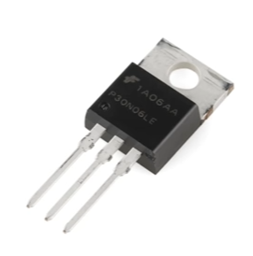
Field Effect Transistor (FET)

Slide 2
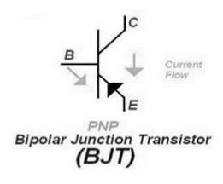
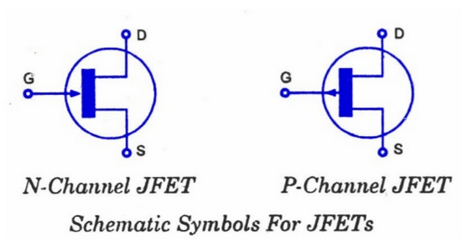
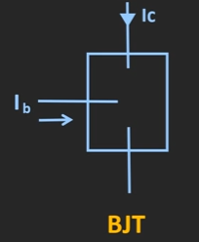
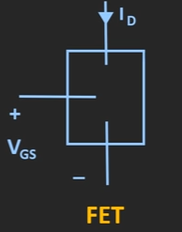
BJT and FET
Current controlled current source
Voltage controlled current source
UNIPOLAR DEVICE
EITHER e or h
BIPOLAR DEVICE
BOTH e or h

Slide 3
BJT and FET
High input impedance – buffer amplifier
Low power consumption - In integrated circuit
Acting as analog switch
As amplifier

Slide 4
INTRODUCTION
The field-effect transistor (FET) is a type of transistor
FETs are unipolar transistors as they involve single-carrier-type operation.
The device consists of an active channel through which charge carriers, electrons or holes, flow from the source to the drain. Source and drain terminal conductors are connected to the semiconductor through ohmic contacts.

Slide 5
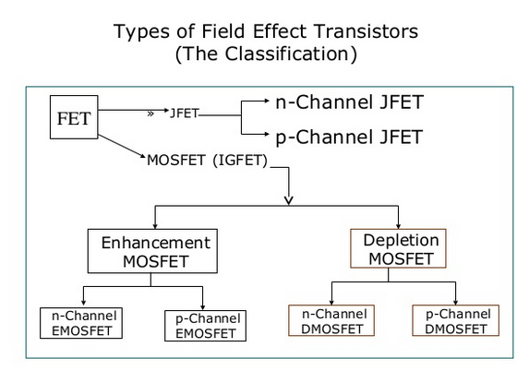
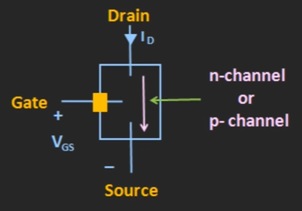
Classification

Slide 6
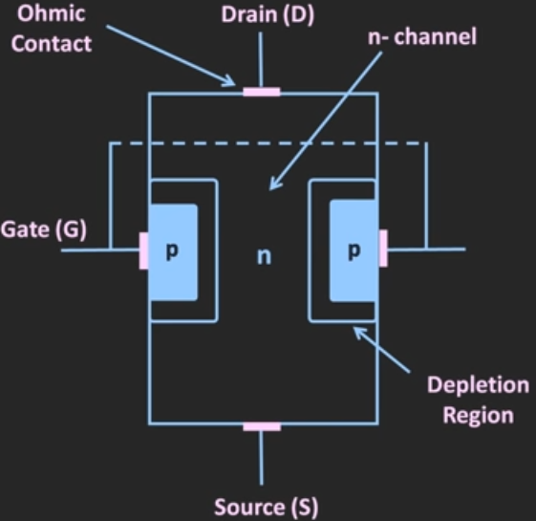
Operation of JFET

Slide 7
The channel is n type in the fig. so it is n- channel JFET
Two ‘p’ regions are constructed near to the channel.
These regions are connected to form the gate terminal
Two ohmic contact is there to connect to drain and source terminals

Slide 8
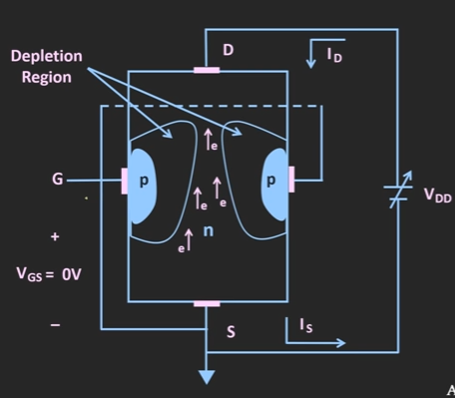
Operation of JFET

Slide 9
Operation of JFET
When neither any bias is applied to the gate (i.e. when VGS = 0) nor any voltage to the drain w.r.t. source (i.e. when VDS = 0), the depletion regions around the P-N junctions , are of equal thickness and symmetrical.
When positive voltage is applied to the drain terminal D w.r.t. source terminal S without connecting gate terminal G to supply.
The electrons (which are the majority carriers) flow from terminal S to terminal D whereas conventional drain current ID flows through the channel from D to S. Due to flow of this current, there is uniform voltage drop across the channel resistance as we move from terminal D to terminal S. This voltage drop reverse biases the diode.

Slide 10
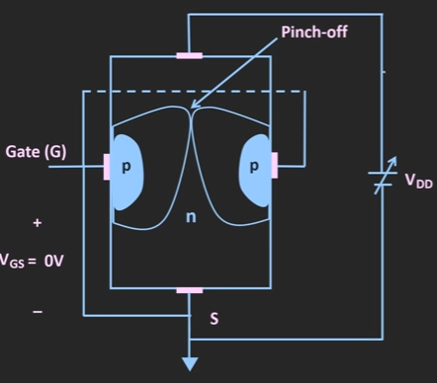
Pinch off condition

Slide 11
Pinch off
As the VDS increases, the channel width decreases, and its resistance increases.
At a particular voltage (pinch off voltage ) two P-N junctions will touch each other – called pinch off condition. ID =0
Practically, ID will not equal to zero, it will reach to a saturation value (IDss)

Slide 12
Ref
https://www.youtube.com/watch?v=2I_8YNVgbEw
https://www.youtube.com/watch?v=cOICDYuY-gA

Slide 13
Thank You

